Slide 1
Ferrocene is an orange crystalline solid, which melts at 173°--I74°C without decomposition. The vapor pressure of this compound has been measured up to 400°C, and a molecular weight of 186 has been calculated for the vapor, indicating it is undissociated and monomeric over the temperature range investigated. From these measurements the normal boiling point has been calculated to be 249°C. Ferrocene is readily soluble in common organic solvents such as benzene, ether and ethanol. It is insoluble in aqueous medium and remains unaffected by water, 10% sodium hydroxide solution, and even boiling concentrated hydrochloric acid.

Slide 2
The ultraviolet spectrum of ferrocene in ethanol or hexane shows maxima at 325 nm and 404 nm.
The infrared spectrum is strikingly simple. There is a single sharp absorption peak at 3.27 μ in the C-H stretching region, suggesting that all the carbon to hydrogen bonds in the molecule are equivalent. There are only four other strong absorption bands, at 12.15 μ, 9.95 μ, 9.00 μ, and 7.05 μ. It is interesting to note that the bands at 9.95 μ and 9.00 μ are retained in all monosubstituted derivatives of ferrocene but disappear when both rings are substituted. This observation has proved very useful in structural determinations
Y μm = 10⁴ / X cm⁻¹
JACS, 1958, 80, 5443
J. Chem. Edu., 34, 1957, 268

Slide 3
Ferrocene has been the subject of two previous communications from this Laboratory.3·4 In the first of these, evidence was presented on the basis of which structure I or II was advanced for ferrocene. The validity of this suggestion subsequently was confirmed by X-ray crystallographic studies,5-7 the results of which unequivocally established the antiprismatic formulation (I) for ferrocene in the crystalline state.

Slide 4
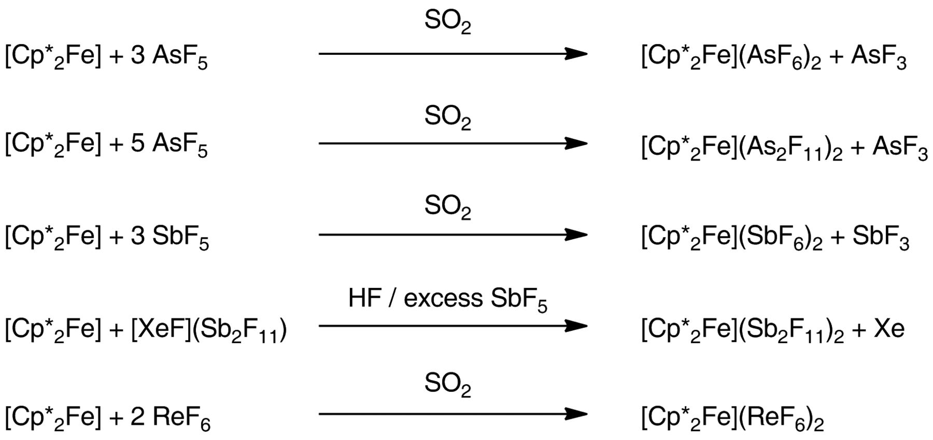

Fig. 1 Synthetic routes to the various [Cp*2Fe]2+ salts.
Cp* is decamethyl derivative of ferrocene
M. Malischewski et al. Science 2016;353:678-682
Copyright © 2016, American Association for the Advancement of Science
Notes:
Synthetic routes to the various [Cp*₂Fe]²⁺ salts.

Slide 5
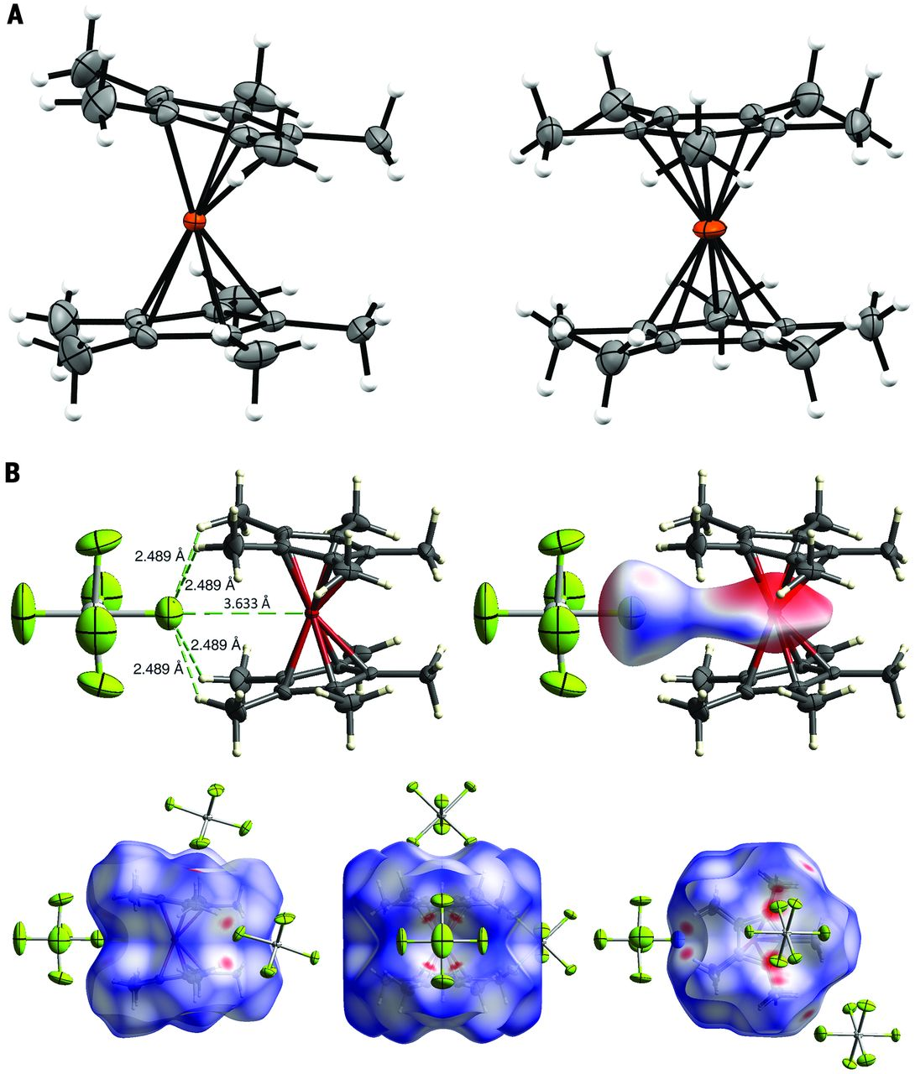
Fig. 2 Crystallographic analysis.
Molecular structures of [Cp*₂Fe]²⁺ in crystals of [Cp*₂Fe](SbF₆)₂·2HF (left) and [Cp*₂Fe](Sb₂F₁₁)₂ (right). Orange, Fe; gray, C; white, H; counter anions and cocrystallized HF are omitted for clarity (50% probability ellipsoid).
(B) Representative distances between [Cp*₂Fe]²⁺ and SbF₆– in crystals of [Cp*₂Fe](SbF₆)₂·2HF (top left) with Hirshfeld surface analysis, highlighting regions of increasing intermolecular interactions from blue to red.
M. Malischewski et al. Science 2016;353:678-682
Copyright © 2016, American Association for the Advancement of Science
Notes:
Crystallographic analysis. (A) Molecular structures of [Cp*₂Fe]²⁺ in crystals of [Cp*₂Fe](SbF₆)₂·2HF (left) and [Cp*₂Fe](Sb₂F₁₁)₂ (right). Orange, Fe; gray, C; white, H; counteranions and cocrystallized HF are omitted for clarity (50% probability ellipsoid). (B) Representative distances between [Cp*₂Fe]²⁺ and SbF₆– in crystals of [Cp*₂Fe](SbF₆)₂·2HF (top left) with Hirshfeld surface analysis, highlighting regions of increasing intermolecular interactions from blue to red.

Slide 6
In the crystal structure at room temperature, denoted as ferrocene I, of monoclinic space group P2₁/n, the Fe²⁺ cation is located at the inversion center and sandwiched between parallel staggered cyclopentadienyl (Cp) rings. It was found later that this ferrocene I structure is also common for other prototypic metallocenes, for example, NiCp₂, VCp₂, and MgCp₂.
J. Phys. Chem. Lett. 2013, 4, 4032−4037
The sandwich-like structure of FeCp₂ had been deduced from spectroscopic data before the Xray diffraction studies were performed. Later, low-temperature studies of ferrocene evoked doubts regarding the molecular conformation: below 164 K, ferrocene I transforms to a triclinic phase II, space group P1̅, where two symmetry independent molecules are located at general positions and the Cp rings divert by ∼9° from the eclipsed conformation. The structure of this triclinic ferrocene phase II is closely related to the monoclinic ferrocene phase I because the main transformation concerns the molecular conformation and displacements of the positions of molecules are small.

Slide 7
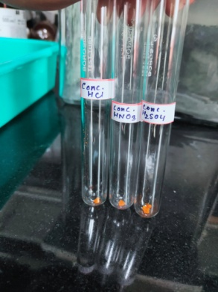
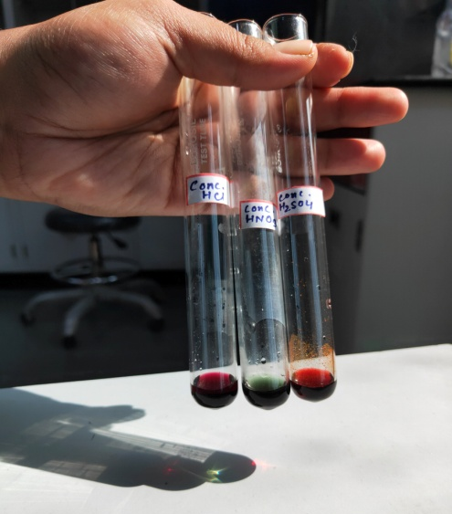
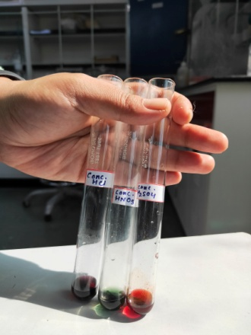

Slide 8
ESI-MS of Acetylferrocene

Slide 9
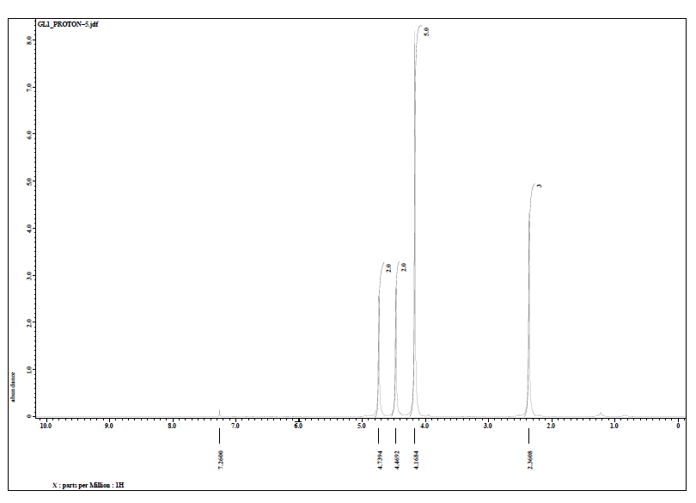
Acetyl ferrocene

Slide 10
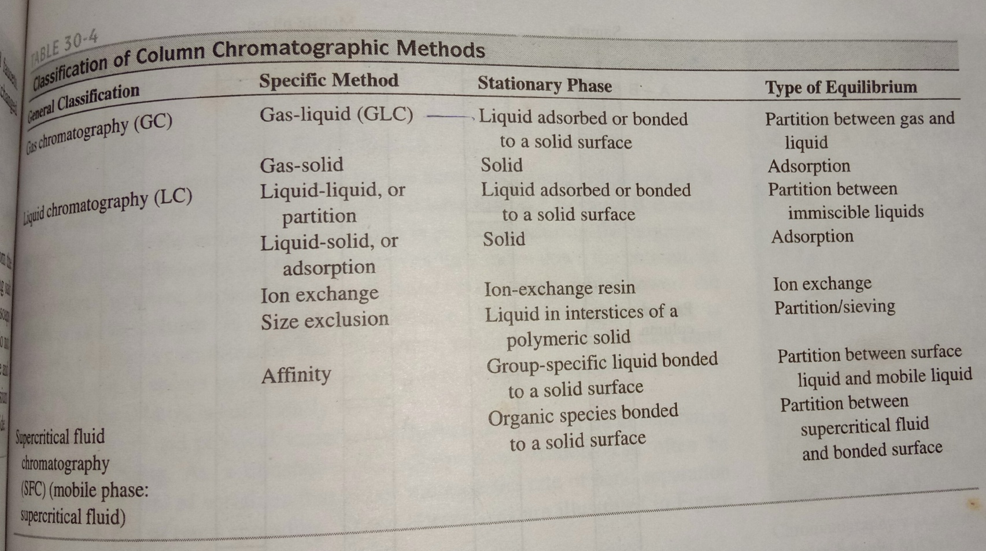
Chromatography

Slide 11
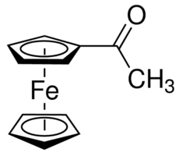
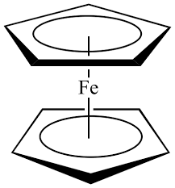
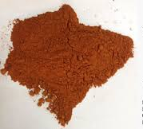
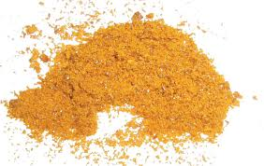
Experiment 2
Acetylation of Ferrocene
Ferrocene is an organometallic compound
molecular formula Fe(η⁵-C₅H₅)₂

Slide 13
Miller, S. A., Tebboth, J. A. & Tremaine, J. F. Dicyclopentadienyliron. J. Chem. Soc. 632–635 (1952)

Slide 17
Wilkinson, G., Rosenblum, M., Whiting, M. C. & Woodward, R. B. The structure of iron bis-cyclopentadienyl.
J. Am. Chem Soc. 74, 2125–2126 (1952)

Slide 18
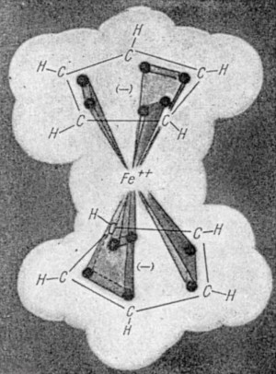
The first use of X-ray crystallography to help decipher the structure of what had now been christened 'ferrocene' by Woodward and co-workers was described by Fischer and Wolfgang Pfab later in 1952. Preliminary data about the symmetry of the molecule and the size of the unit cell were much more consistent with the sandwich structure than the linear one. Two further X-ray crystallographic studies finally confirmed the sandwich structure of ferrocene, with the iron atom, indeed providing the metallic filling in a pentagonal antiprism defined by two parallel cyclopentadienyl rings.
Milestone 10
An iron-clad structure
Ferrocene
Stuart Cantrill
Nature volume 511, page11(2014)

Slide 19
Woodward, R. B., Rosenblum, M. & Whiting, M. C. A new aromatic system.
J. Am. Chem. Soc. 74, 3458–3459 (1952)

Slide 20
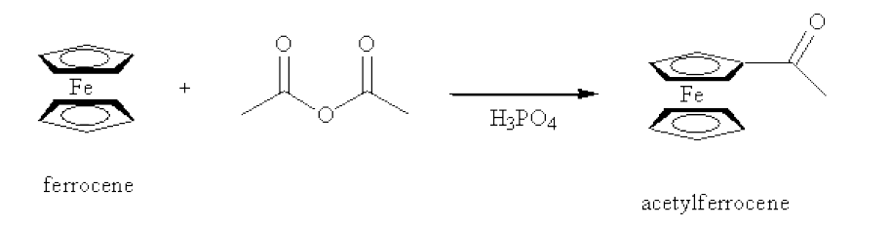
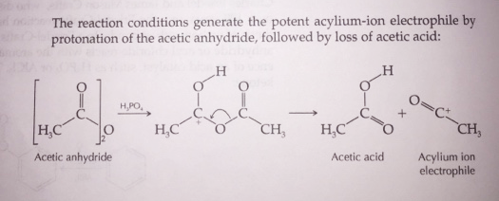
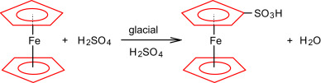
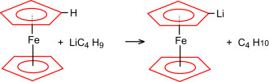
Friedel–Crafts Acylation
Electrophilic aromatic substitution

